Slide 1
SpeakOut with Advocatr
Curriculum
Lesson 8
Thinking about POWER
Over, with, to, within?
Notes:
Ask the students to come up with examples of each term:
What is power over? What is an example?
Some reflections on power over: Often uses intimidation or threats, and tries to create uncertainty so powerful people aren’t challenged. They often dehumanize other people and think empathy and kindness are weak.
Power with/for/to/within involves sharing power with, empowering other people to, and inspiring people to develop power within. People who power with/for or to others tend to value emphathy and kindness and act in service to others. For transformative power people, getting it right is more important than being right. They often value multiple perspectives on important questions and are willing to change their minds and admit when they are wrong. Vulnerability is a strength for these people. (Source: Brene-Brown-on-Power-and-Leadership-10-26-20.pdf)

Slide 2
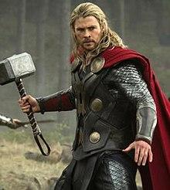
When we think of power, what (or who) comes to mind?
Notes:
Encourage thoughts not just about the “power” of Thor as a god and superhero, but also as a media character who influences how we think about power, physicality, attractiveness, whether man or woman, etc. In the next slides, we’ll consider what else “power” can be in addition to a strong hammer-wielding god.

Slide 3
Quick definitions:
Power within
Self-awareness/self-worth;
realization of one’s ability to act
Power to
Ability to create change and
take action
Power with
Social power, capacity for
collective action
Power over
Exerting control/influence
Over others

Slide 4
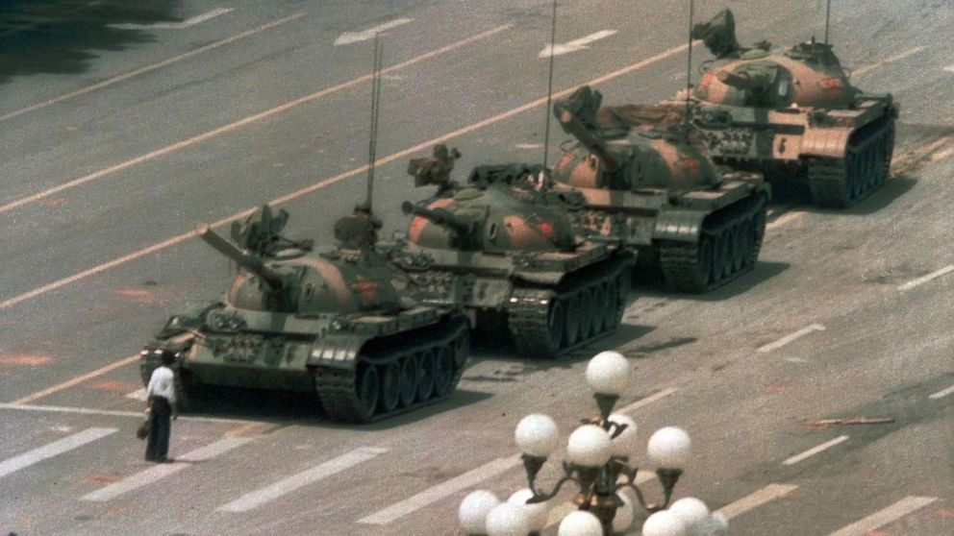
University student blocking tanks that were sent to disrupt a peaceful protest. Tiananmen Square, China 1989
(The student was not hurt by the tank. Accounts vary regarding whether he was arrested, went into hiding in mainland China, or escaped to Taiwan where he now works as a archaeologist.)
Notes:
Questions: Who seems to hold more power in this photo? Are there different kinds of power demonstrated here? More information about this photo: the lead tank kept trying to move around the young man, who continued to step in front to block its way. What kind of power is the young man exercising?

Slide 5
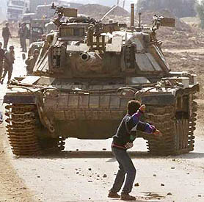
Faris Odeh, a 14 year old Palestinian boy, throwing a rock at an Israeli tank in the occupied Gaza Strip.
Notes:
Who seems to hold more power in this photo? Are there different kinds of power demonstrated here? What might have been the impact of Odeh’s power?
Depending on your class, you may wish to include more context: Odeh was shot and killed by Israeli soldiers 10 days later throwing rocks at a different tank. This photo mobilized thousands to criticize Israel’s methods; it also seems to have encouraged the Israeli forces to change their policy to fire upon on rock-throwers (1)

Slide 6
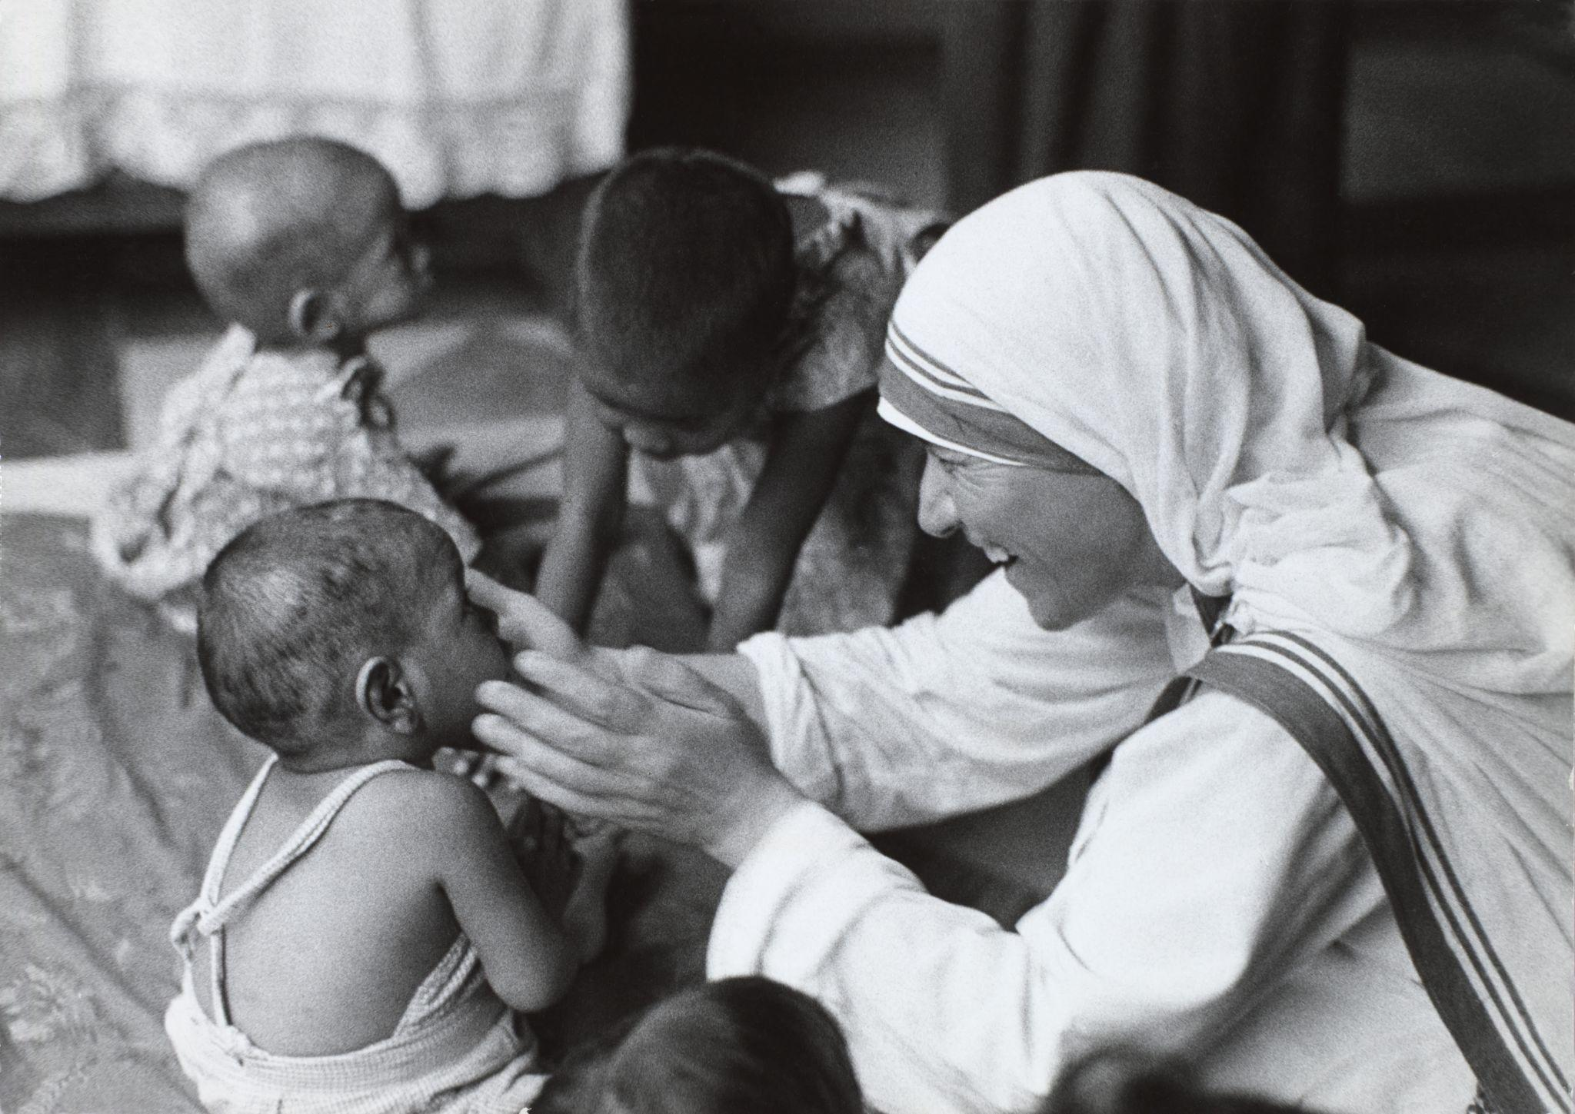
Here Mother Teresa is comforting a starving child. She brought food and medicine to the poorest communities in the India and other parts of the world for 60 years.
Compared with Thor, what kind of power does Mother Teresa have?
What are possible impacts of Mother Teresa using her power?
Notes:
Mother Teresa saved thousands of lives of the sick and hungry, using compassion. How might we describe Mother Teresa’s power? What was its impact?
How does Mother Teresa’s kind of power relate to building trust?

Slide 7
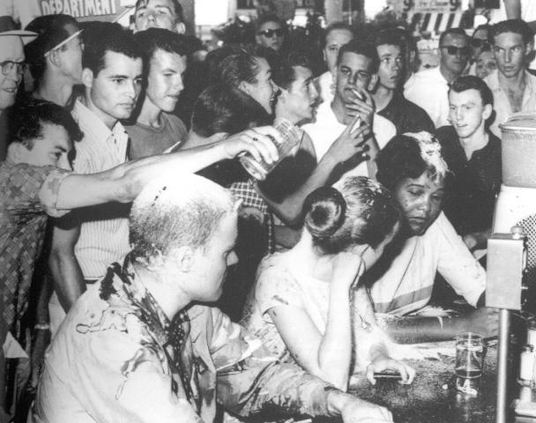
Civil Rights protestors staging a sit-in, asking to be served at a lunch counter with a “Whites only” policy. White patrons burned them with cigarettes and poured water, salt, and coffee on them. The protestors did not fight back but practiced non-violent resistance. Mississippi, 1963
Notes:
What kind of power are the protestors exercising here? What were their possible impacts?
The Civil Rights Movement in the mid-1960s brought about legislation in this country (the Civil Rights Act, 1964) that federal law enforcement agencies the power to prevent racial discrimination in employment, voting, and the use of public facilities.
In this scene, how do the different kind of powers in this photo relate to building trust? To breaking trust?

Slide 8
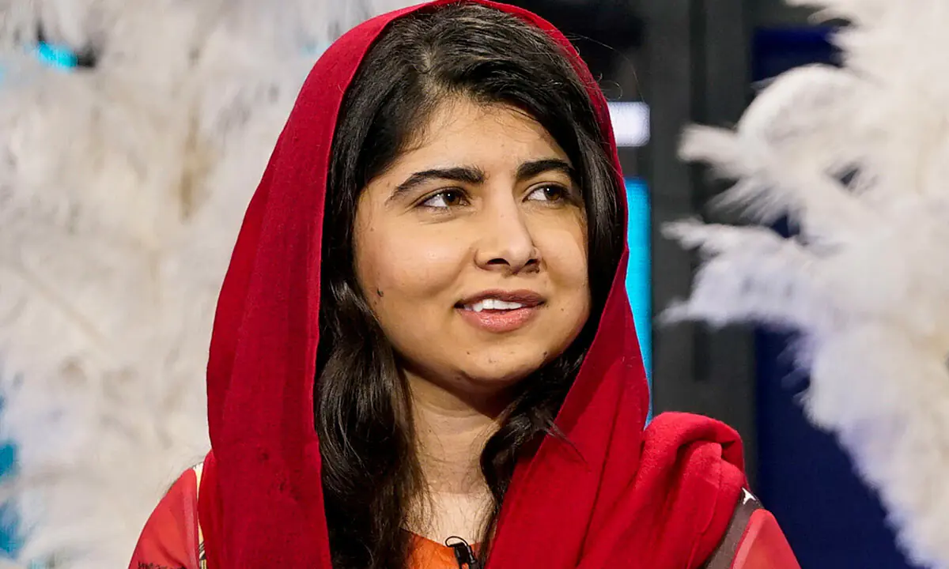
Malala Yousafzai was shot in the head at age 14 by the Taliban for promoting education for girls in Pakistan. She survived, and won the Nobel Peace Prize in 2014.
Notes:
How might we describe Malala Yousafzai’s power? What was its impact?

Slide 9
Disney character Moana, calming a life goddess turned lava monster in order to restore her heart.
Notes:
Finally, in this scene from the movie, Moana stands up to an enormous lava monster. What kind of power is Moana practicing in this scene? What is its impact? Was trust built or broken?

Slide 10
Questions for personal reflection in your journals
Take 10 minutes to write or draw in your journals your responses to these questions
Think of a time when you powered over someone. What happened? Who was impacted? Did it affect trust?
Think of a time when you practiced power with or for someone, or acted in a way that someone felt powerful within. What happened? What was the impact? Did it affect trust?

Slide 11
Questions for partner pair-share
Take 2 minutes each to answer the following questions:
What were the impacts of powering over compared with powering with, for or within?
For you, how do these types of power relate to building trust?

